Slide 1
CE 3372 Water Systems Design
DRINKING WATER storage Part 1 (FALL 2020)

Slide 2
Storage
Storage is used in water supply, storm water management, and wastewater systems for a variety of reasons.
SERVICE STORAGE
flow equalization — generally things are designed for a particular steady flow rate and storage can be used to accommodate variable flow rates in a system.
Pressure zone maintenance
EMERGENCY STORAGE
used to provide supply during repairs and other system interrupts
FIRE STORAGE
used to provide supply during fire fighting activities – could logically be considered as part of emergency
Storage is either elevated (above grade), at grade (reservoir, tanks, ponds, etc.) or below grade (subsurface vaults — NOT AQUIFERS).

Slide 3
Storage Compartments
Service storage
Emergency storage
Fire Storage
Service
Emergency
Fire

Slide 4
Flow-equalization
Flow-equalization storage is sufficient storage to account for peak demands in the system without having to exceed supply capacity.
A desirable volume is 1-2 days of average daily demand.

Slide 5
Fire storage
Fire storage is sufficient storage to allow the system to meet routine uses plus substantial fire flow.
The desirable volume is based on expected fire flow rates multiplied by the required fire flow duration.

Slide 6
emergency storage
Emergency storage to allow the system to operate without external supply sources for a period of time to allow for repairs or other unusual circumstances.
Without emergency storage, every upset will lead to a ”boil-water” order or substantial interruption of service — these kinds of interruptions should be rare if the system is well engineered.
A desirable volume is 1-2 days of average daily demand.

Slide 7
How much?
Engineering would tend to choose for the larger volumes
Economics will argue for the smaller volumes
The engineer will have to balance these competing choices in a design.

Slide 8
Residence time
Additionally, residence times in any storage reservoir for TREATED water should not exceed a reasonable amount disinfection residual contact time.
For chlorine/chloramine disinfection time is on the order of 6-10 days
An hydraulic retention time of any such reservoir should be no longer than 8 days (as a reasonable rule of thumb).

Slide 9
Hydraulic Retention Time
Hydraulic retention time is the ratio of storage volume to average discharge through the reservoir

Slide 10
How much? Flow Equalization
Operating (flow-equalization) storage is determined as follows:
Determine the hourly demand for a typical design day.
Compute the cumulative draft (cumulative volume as a function of time)
Compute the average constant draft rate (flow rate that if applied over the day end at the same accumulated value)
The equalization storage is the sum of the two largest deviations from the average flow line to the cumulative draft line.

Slide 11
Service Storage
Purpose of storage reservoirs
Types of reservoirs
Calculating storage requirements

Slide 12
Storage Reservoirs
Equalizing or Operating Storage
Equalize pumping rate into reservoirs
Provide storage for peak demand times
Provide system pressure without booster pumping
Fire and emergency pressures
Types
Surface reservoirs
Standpipes
Elevated tanks

Slide 13
Surface Reservoirs
Where natural elevation is high enough
For inexpensive pumped storage
Covered for protection (contamination, algae growth, evaporation)
Good temperature control

Slide 14
Standpipes
Vertical cylindrical pipe
Height > diameter
Useful storage = volume above elevation needed for minimum pressure
Low storage useful for emergencies
Steel, reinforced concrete

Slide 15
Elevated Storage
Usually less $/volume of useful storage
Foundation design important
Wind uplift
Earthquake stress
General types
Hemispherical bottom (50-75000 gal)
Double ellipsoidal (< 1.5 MG)
Radial cone bottom (up to 3 MG)
Hydropillar (up to 3 MG)

Slide 16
CB&I (formerly Chicago Bridge & Iron) Water Tanks

Slide 17
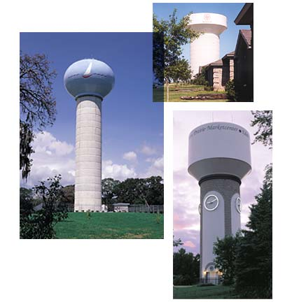
Composite Elevated Tanks

Slide 18
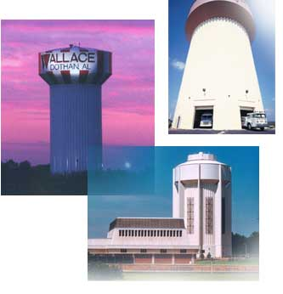
Hydropillar™

Slide 19
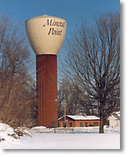
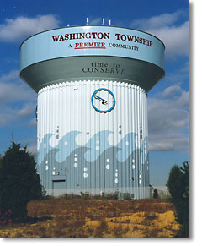
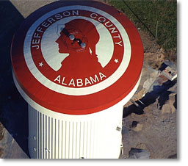
Hydropillar

Slide 20
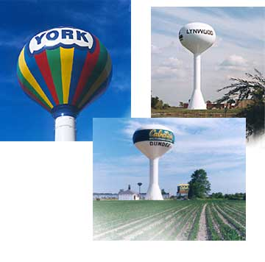
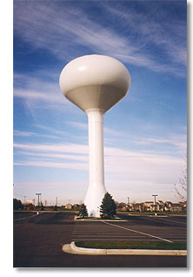
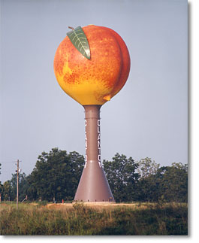
Water Spheroids

Slide 21
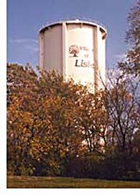
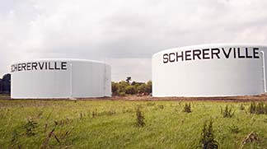
Standpipe Ground Level

Slide 22
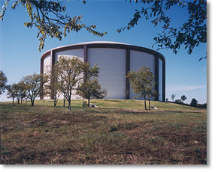
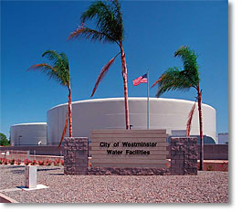
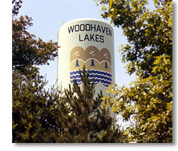
Standpipes and Reservoirs

Slide 23
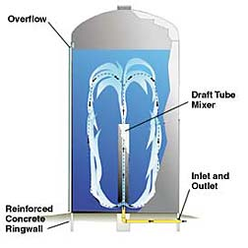
Freshmix™ Standpipe Mixing

Slide 24
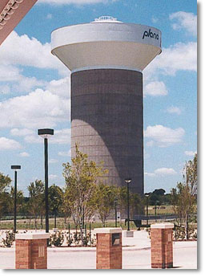
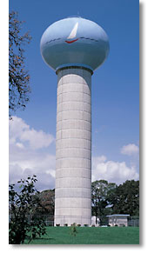
Composite Elevated Tanks
Standard CET Dimensions
Capacity (in U.S. gallons) | Tank Diameter (in feet) | Head Range (in feet) | Pedestal Diameter (in feet)
1,000,000 | 70 | 40 | 36
1,500,000 | 87 | 40 | 48
2,000,000 | 94 | 45 | 52
2,500,000 | 105 | 45 | 60
3,000,000 | 118 | 45 | 64

Slide 25
Operating Storage
Determine hourly demand for design day
Calculate cumulative draft
Plot cumulative draft vs. time (24 hr)
Draw diagonal line representing constant pumping
Read required storage as sum of two maximum ordinates

Slide 26
Mass Diagram (24-hr pumping)

Slide 27
Mass Diagram (12-hr Pumping)

Slide 28
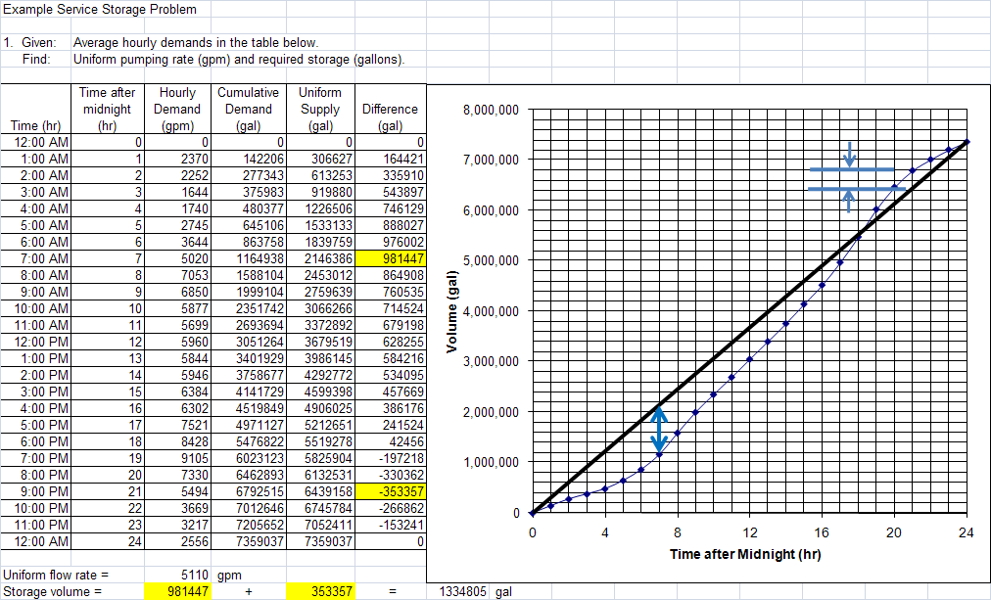

Slide 29
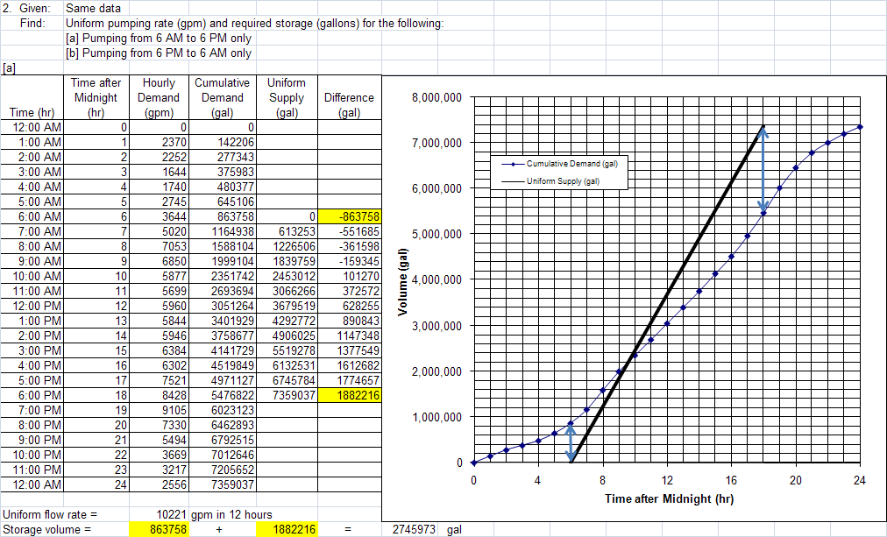

Slide 30
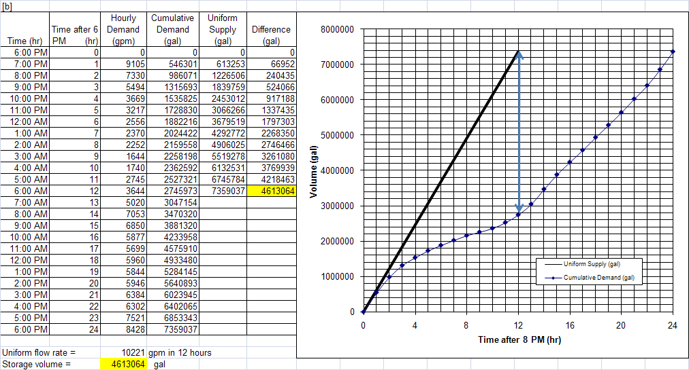

Slide 31
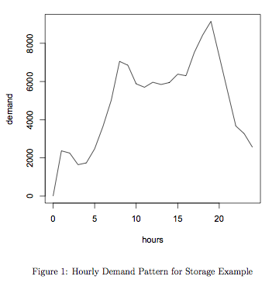
Flow Equalization Storage
Demand pattern from historical data appropriate to the service area.

Slide 32
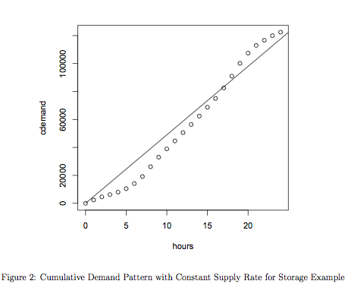
Flow Equalization Storage
Accumulate the demand

Slide 33
Flow Equalization Storage
Average constant draft

Slide 34
Flow Equalization Storage
Sum the 2 largest deviations
Storage required V1+V2
In this chart, about 25000 volume units.
V2
V1

Slide 35
Flow Equalization
The engineer needs to decide which demand to use:
Daily
Peak
These volumes are added to that needed for emergency and fire flow.
Determines the tank volume required
Tank type (elevated, at-grade, buried) determines shape – elevation, diameter, min-level, max-level.
Elevated tanks have substantial structural considerations

Slide 36
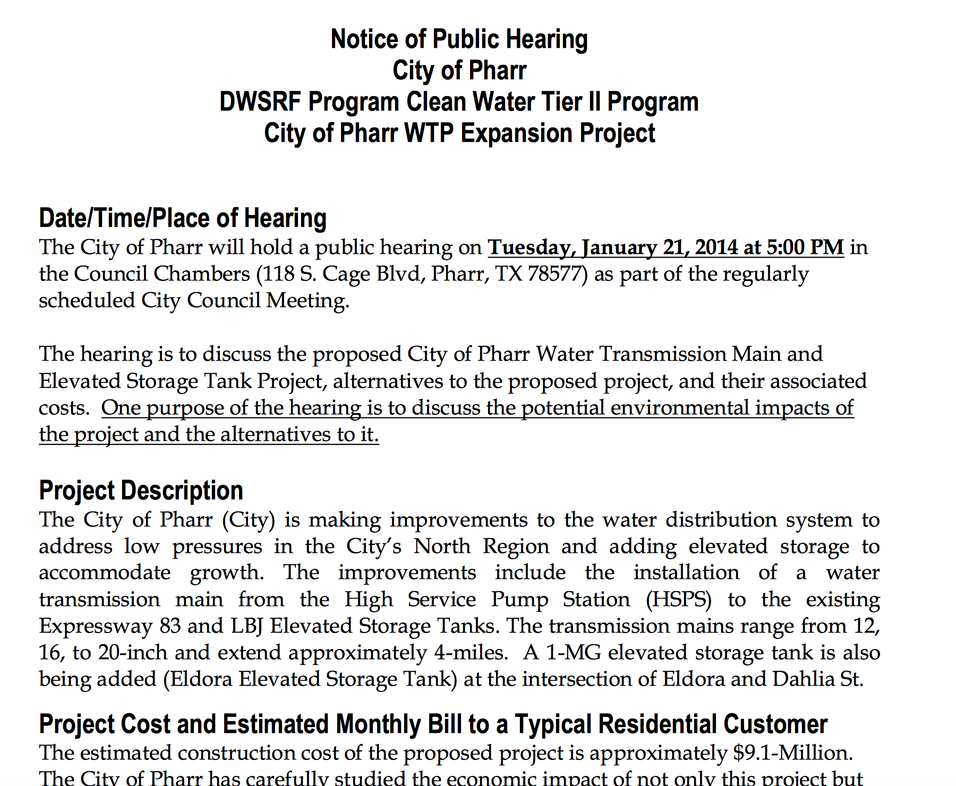
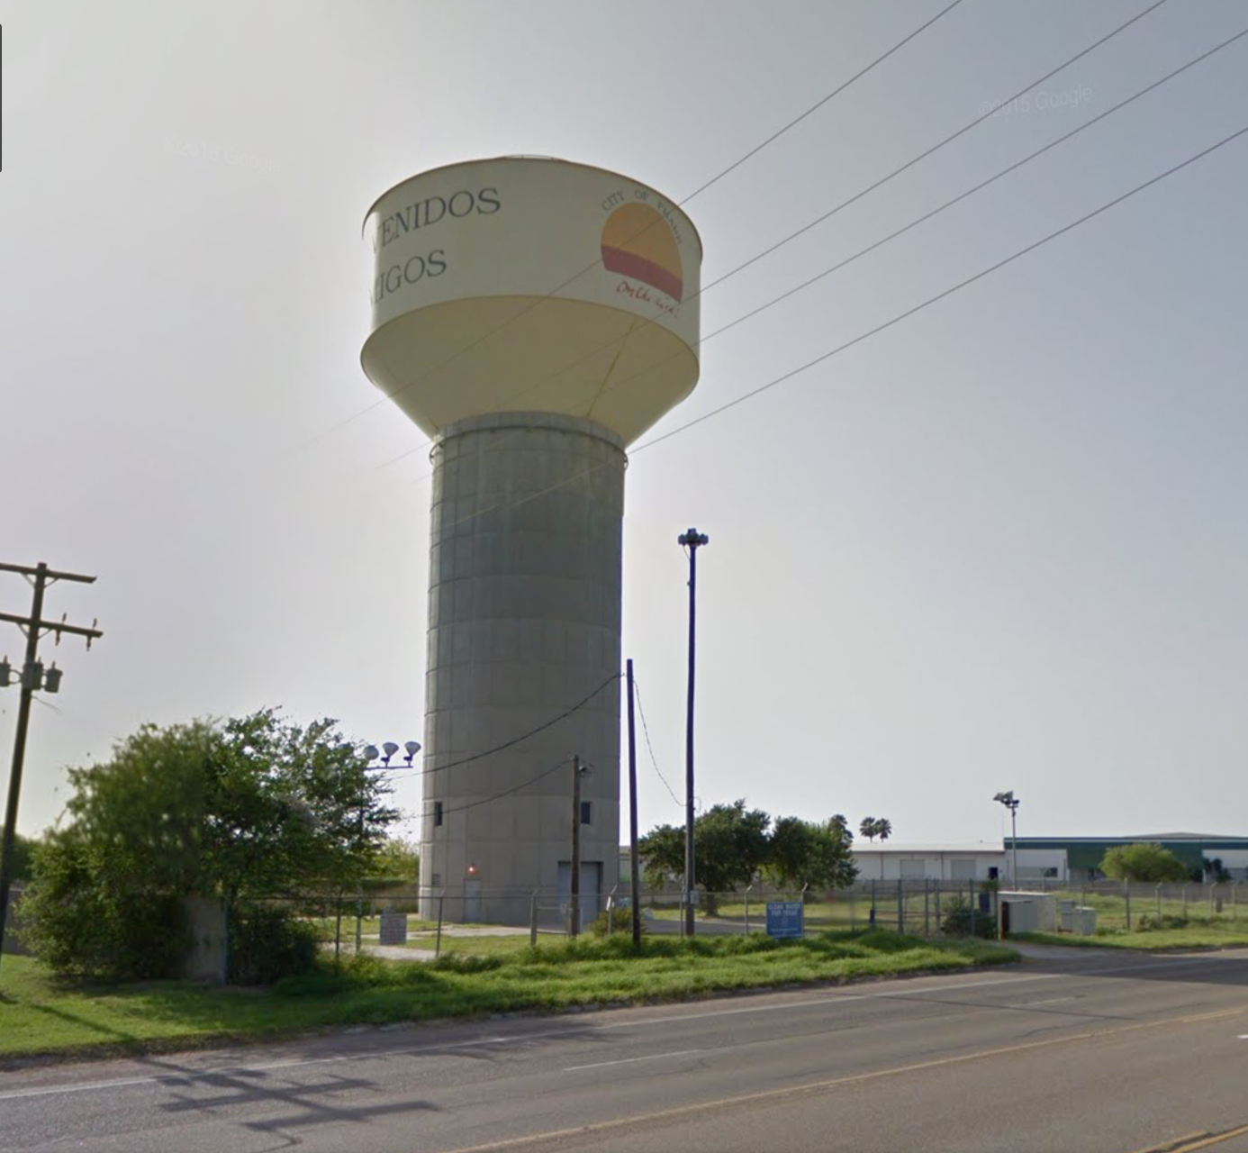
Typical installation

Slide 37
Storm Water Storage
Used to mitigate peak flows from development.
Provide water quality benefit.
Develop a water resource (rainwater harvesting)

Slide 38
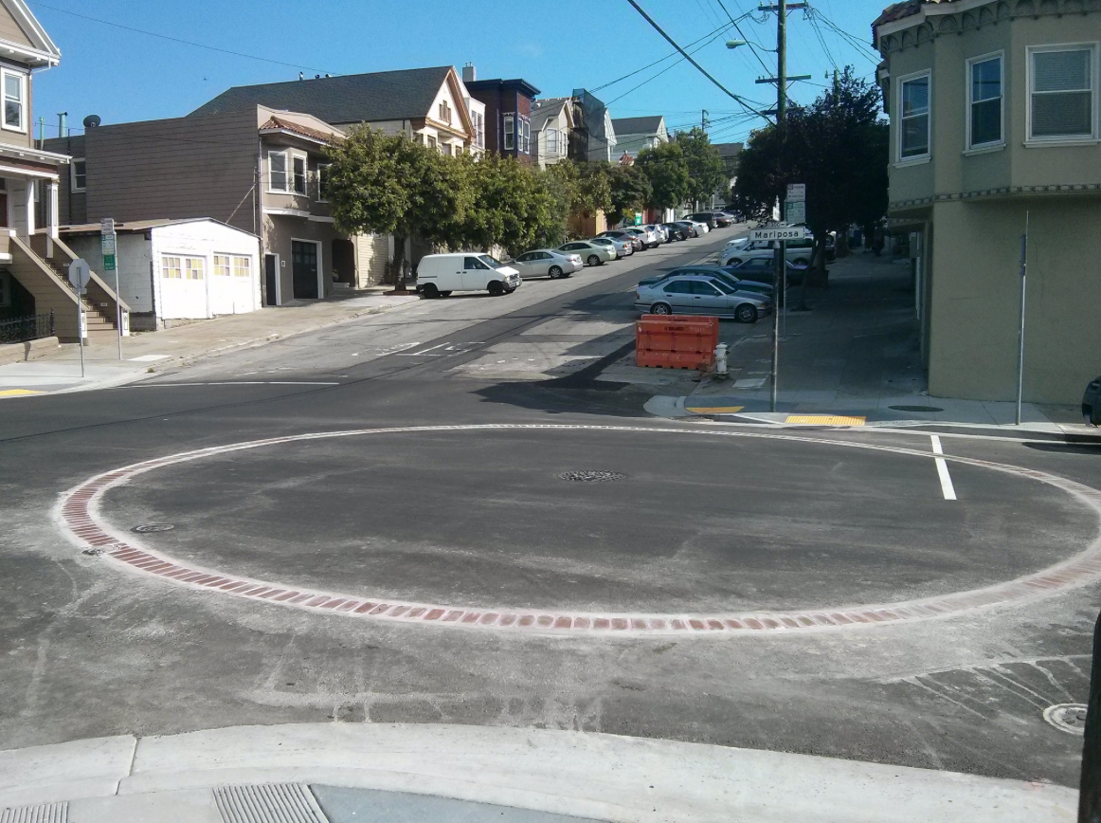
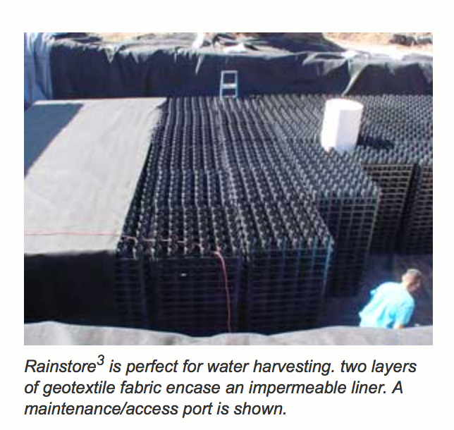
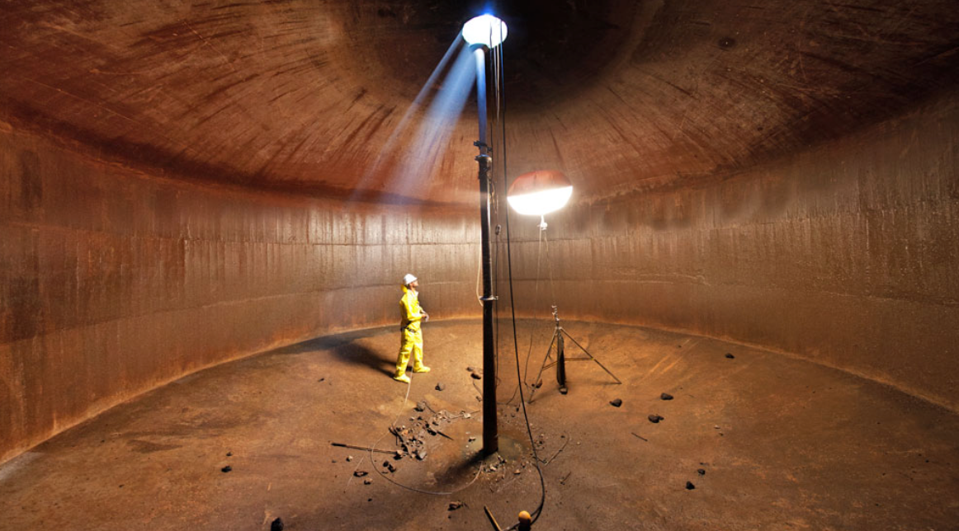
Underground “tank”
More than a hole in the ground
Needs structure to support surface loads
Needs a way to drain completely (usually a pump)

Slide 39
STORAGE IN COMPUTER MODELS
Storage elements in computer models are tanks or reservoirs (EPANET), or storage junctions (SWMM)
Have similar minimal data requirements that include:
Invert (bottom) elevation
Min Pool elevation (above the invert)
Begin Pool elevation (above the invert)
Max Pool elevation (above the invert)
Tank dimensions (or depth-storage curve)

Slide 40
Tank DESCRIPTIONS
Supply reservoir (or tank); identify reservoir pool elevation
May need to make configuration assumptions
Tank dimensions should be sensible
Pipe length is given (or assumed based on min level and connecting node elevation)
Diameter
Z=315 ft
Max Level
Z=300 ft
Min Level
L₂=120 ft
Node 2
Pipe 8: L₁ + L₂ = 300 ft
Z=180 ft
Elevation
L₁=180 ft
Notes:
Globe is most used.

Slide 41
Tank DESCRIPTIONS
Supply reservoir (or tank); identify reservoir pool elevation
Can also use a volume vs. depth table to convey tank storage capabilities -- quite similar to reservoir routing in hydrology
Diameter
Z=315 ft
Max Level
Z=300 ft
Min Level
L₂=120 ft
Node 2
Pipe 8: L₁ + L₂ = 300 ft
Z=180 ft
Elevation
L₁=180 ft
Notes:
Globe is most used.

